Slide 1
Purchase Pattern Analytics

Slide 2
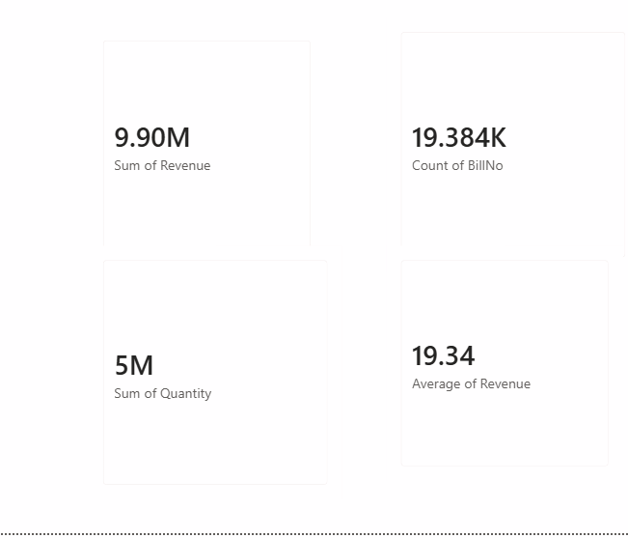
Cards
This card represents the total revenue generated.
The total revenue shown is approximately 9.90 million.
It summarizes revenue from all available transactions.
The value gives an overall view of business sales performance.
Revenue is an important indicator of business growth.
It can be compared with different countries and products.
It can also be analyzed by month and year using the dashboard filters.
Higher revenue indicates stronger sales value.
The KPI helps management quickly understand overall performance.
It is one of the main indicators in the Purchase Pattern Analysis.

Slide 3
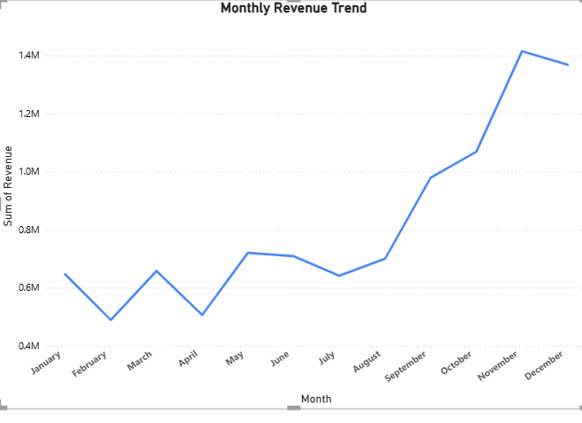
Monthly Revenue Trend
The chart shows the monthly revenue pattern from January to December.
Revenue changes throughout the year with some fluctuations.
January starts with a moderate revenue level.
Revenue decreases slightly in February.
Revenue increases again during March and May.
A small decline can be observed during June and July.
Revenue begins to increase from August onwards.
September and October show stronger revenue performance.
November records the highest revenue in the displayed trend.
The overall trend indicates stronger revenue toward the end of the year

Slide 4
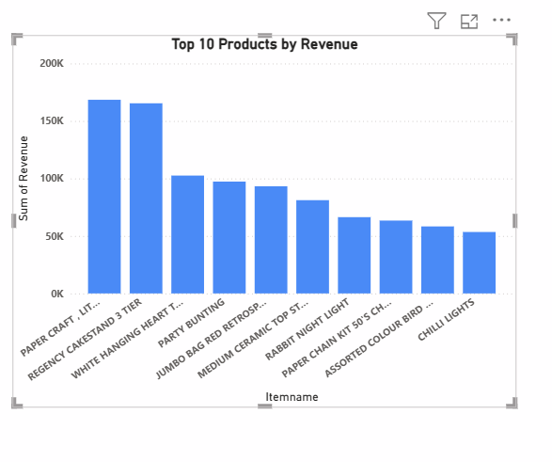
Top 10 Products By Revenue
This chart displays the 10 products generating the highest revenue.
Products are arranged according to their revenue contribution.
The first product has the highest revenue among the displayed products.
The leading products contribute significantly to total revenue.
Revenue varies between the different products.
The chart helps identify high-value products.
Products with higher revenue may require greater business attention.
Lower-ranked products generate comparatively less revenue.
This information can support product-focused marketing strategies.
The chart helps management identify the most profitable products by revenue.

Slide 5
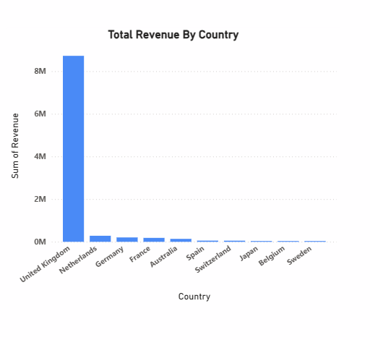
Total Revenue By Country
This chart compares total revenue across different countries.
The United Kingdom has the highest revenue in the displayed chart.
The United Kingdom contributes significantly more revenue than the other countries shown.
The Netherlands, Germany, France, and Australia contribute comparatively lower amounts.
Revenue varies considerably between countries.
The chart helps identify the strongest geographical market.
Country-wise analysis helps understand market performance.
High-performing countries may provide greater business opportunities.
Lower-performing countries can be studied for potential improvement.
This chart supports geographical sales and market analysis.

Slide 6
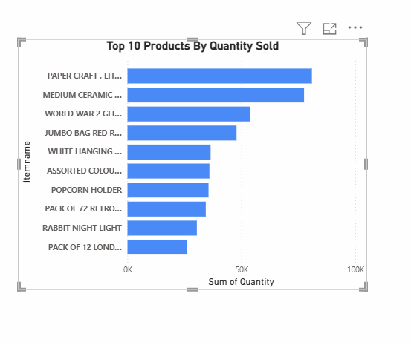
Top 10 Products By Quantity Sold
This chart displays the top 10 products according to quantity sold.
Paper Craft appears as one of the highest-selling products.
Medium Ceramic and World War-related products also show strong quantities.
Jumbo Bag and White Hanger products have significant sales volumes.
Different products have different levels of customer demand.
The chart focuses on quantity rather than revenue.
A product with high quantity does not necessarily have the highest revenue.
The chart helps identify products with strong customer demand.
High-demand products may require better inventory planning.
This visual is useful for understanding product sales volume.

Slide 7
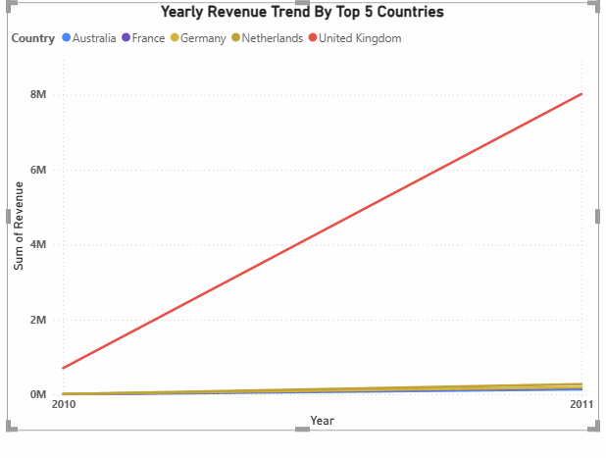
Yearly Revenue Trend By Top 5 Countries
This chart compares revenue trends for the top five countries.
The analysis covers the years 2010 and 2011.
Revenue generally shows an increasing trend between the displayed years.
Australia shows a strong revenue contribution in the chart.
The other countries have comparatively smaller revenue values.
The chart helps compare country performance over time.
It shows how revenue changes from one year to another.
Increasing revenue indicates improved sales performance.
Country-wise yearly comparison helps identify growing markets.
This visual is useful for understanding year-over-year geographical revenue trends.

Slide 8
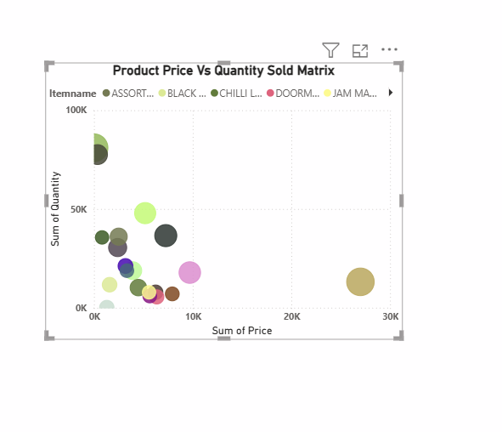
Product Price Versus Quantity Sold Matrix
This visual compares product price with quantity sold.
Each point represents a product or product category.
The horizontal axis represents product price.
The vertical axis represents quantity sold.
Products are distributed across different price levels.
Some products have high quantities even at relatively different price levels.
The visual helps examine the relationship between price and demand.
It can help identify products with high sales quantities.
It can also highlight products with higher prices and lower quantities.
This analysis can support product pricing and sales decisions.

Slide 9
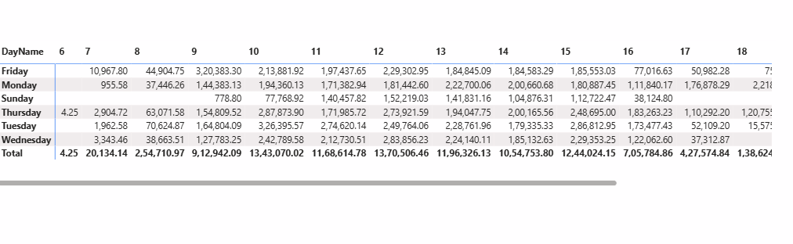
Day Name table
This table presents purchase-related values according to days of the week.
It includes days such as Friday, Monday, Sunday, Thursday, and Tuesday.
Friday shows a high value in the displayed table.
Monday also contributes to the overall purchase activity.
Sunday shows comparatively smaller values in some columns.
Thursday contains values across multiple columns.
Tuesday also contributes significantly to the totals.
The Total row summarizes the values for each column.
Day-wise analysis helps identify periods of higher purchasing activity.
This information can support day-based sales and promotional planning.

Slide 10
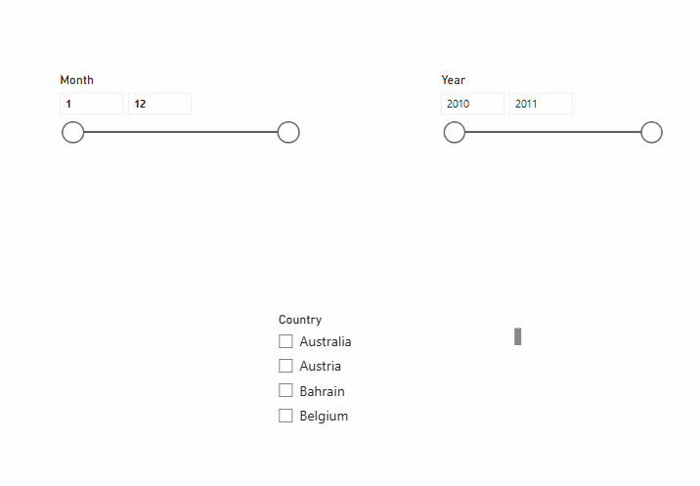
Slicers
The Month filter allows users to select a specific month or range of months.
The dashboard currently shows a range from Month 1 to Month 12.
Users can adjust the range according to their analysis requirements.
Selecting a month changes the dashboard results accordingly.
It helps analyze seasonal purchasing patterns.
Users can focus on a particular period.
It makes the dashboard interactive and easy to explore.
Monthly filtering helps compare different sales periods.
It can be used to identify high- and low-performing months.
The filter supports month-wise purchase pattern analysis.

Slide 11
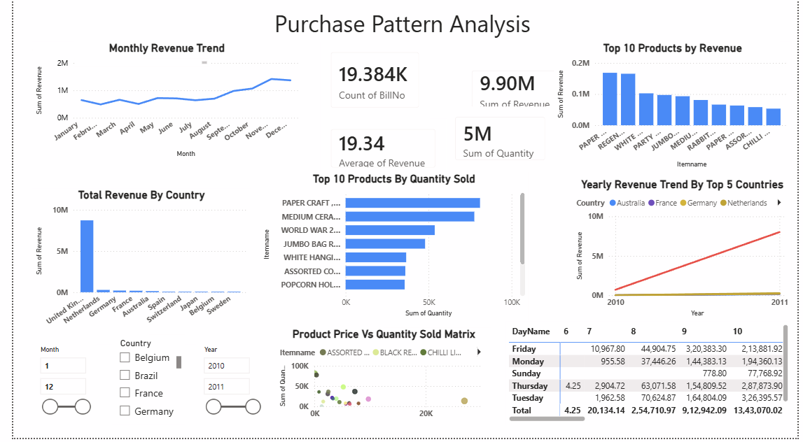
Dashboard

Slide 12
Conclusion
The dashboard provides a clear overview of overall purchase patterns and sales performance.
The analysis shows that revenue generally increases toward the end of the year.
The total revenue generated is approximately 9.90 million.
Around 19.384K transactions are recorded in the dataset.
Approximately 5 million products have been sold.
The analysis identifies the top 10 products based on revenue.
It also identifies the top 10 products based on quantity sold.
Product demand varies significantly across different products.
The United Kingdom is the major revenue-generating country in the displayed analysis.
Country-wise analysis helps identify strong and weaker geographical markets.
Yearly analysis indicates a positive change in revenue between the displayed years.
Day-wise analysis helps understand when purchase activity is higher.
Price and quantity analysis helps understand the relationship between product price and demand.
Interactive filters for month, country, and year make the dashboard useful for detailed analysis.

Slide 13
Thank You

